Slide 1
Exploratory Data Analysis
The Data Analytics Team
ANZ

Slide 2
Agenda
Introduction
Data Exploration
Interpretation

Slide 3
Introduction
Understanding the characteristics of given field in the underlying data such as impact of location on the transactions, age variation and average transaction, whether the data set is skewed more towards a certain demographic and the validity of the fields.
Exploration of interactions between different variables through relation analysis and look out for multi collinearity by creating interaction variables.
Furthermore, transformation of required data so that it is in an appropriate format for analysis.

Slide 4
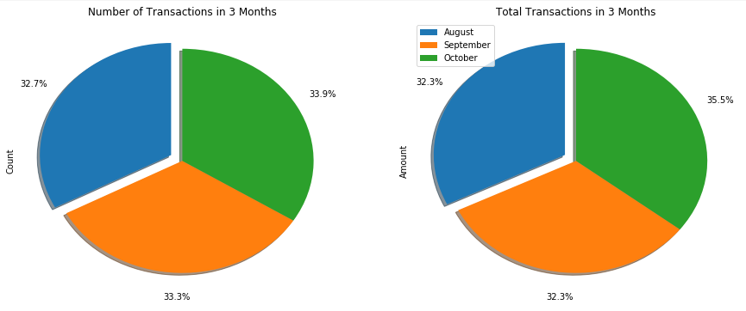
Data Exploration
The Total Number of Transactions in the course of three months amounts to a total of 2.2 Million AUD.
Maximum Number of transaction was accounted in the month of October with 4087 transactions with 33.5 % of the total value.
The months of August and September accounted to a total of
7956 transactions
with 32.3% and
33.3% of the total
value respectively.

Slide 5
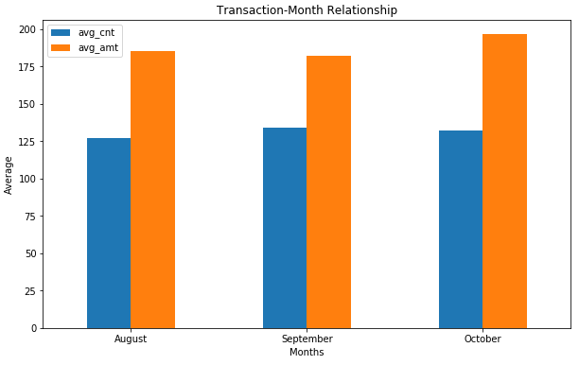
Data Exploration
Transactions – Month Distribution
On an average to total number of transaction in month of August counts to 127 with a total amount of 185 AUD.
Whereas average
transaction in September
was 133 with 182 AUD &
October accounted for 131
transaction with a total of
196 AUD on an average.

Slide 6
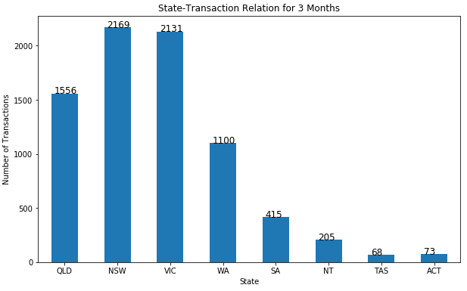
Data Exploration
State Transaction Relation
Australian Capital Territory
(ACT) saw a lowest number
of transactions.
On the contrary state of NSW
had the most number of
transactions followed by VIC
& OLD.
Other states had low impact on the number of transactions as a whole.

Slide 7
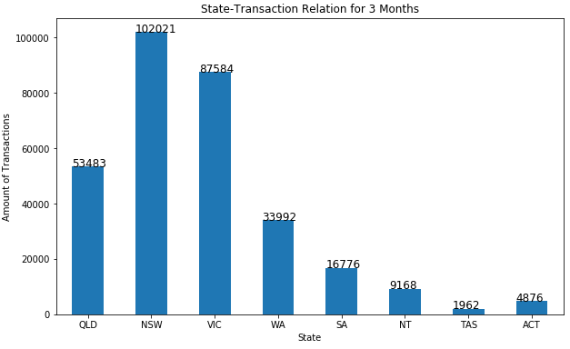
Data Exploration
State Transaction Relation
The total transactions for the
state of NSW was 102 thousand
AUD which is the most,
whereas, ACT had the lowest
amount of transactions clocking
to 4876 AUD.
On the contrary other states had a significant amount of transactions, for VIC it was 87584 AUD, followed by 53483 AUD for QLD.

Slide 8
Interpretation
Following the Data Analysis Phase, the average age was found to be 30 Years and the average transaction was found to be 183 AUD.
The highest amount transacted was 8835 AUD
There are many empty fields for the columns .For example: card_present_flag, bpay_biller_code, merchant_id etc.

